Slide 1

CS 5542 – Big Data Analytics & Apps
Deep 3D Shape Reconstruction from
Single-View Sketch Image
By Team – Alpha Leaners
Harika Garapati
Niharika Pedakolimi
Sai Rishi Tejaswi Papineni
Vinay Reddy Kalluri

Slide 2
Presentation Outline
Introduction
Related Work
Proposed Method
Experiments & Results
Conclusion
References

Slide 3
Introduction
As one of the most fundamental problems in computer graphics, 3D shape reconstruction is playing an increasingly important role in a wide variety of fields such as virtual/augmented reality, computer-aided geometric design, gaming, medical imaging, 3D models is not a trivial task.
It usually takes designers a lot of time and effort to harvest an exquisite 3D model since the procedure involves intensive interactions.
To alleviate this situation, a large body of technologies have been developed to facilitate the 3D shape reconstruction process.
Among them, automatically reconstructing 3D models from sketch images is gaining more and more popularity due to its high efficacy and simplicity of interaction.
Especially with the recent advancements in deep learning technology, sketch-based deep 3D shape reconstruction has achieved remarkable progress.
Unfortunately, there are still many challenging issues in this area that have not been effectively addressed, which is seriously hindering the adoption of this technique in many applications.

Slide 4
Introduction
Challenges
There is a great semantic gap between sketch images and 3D models. Compared with nature images, the sketch is a visual representation form with a high level of abstraction and can easily cause ambiguity.
deep learning-based 3D reconstruction models are generally highly dependent on sufficient training data. As the diversity of users’ painting styles, it is very time-consuming and costly to collect tens of thousands of well-labeled sketch images that can be used to feed into deep neural networks for effective training.
The dimensionality and feature of sketches and 3D models are quite different. How to effectively exploit the very limited visual clues in sketch images to reconstruct 3D shape accurately is another challenging task that is still inadequately addressed by existing studies.

Slide 5
Introduction – Proposed Workflow
A novel 3D shape reconstruction framework from sketch images using a deep neural network.
Conventional methods that need several sketch images from multiple views, the proposed approach only takes single-view sketch images as input.
This can significantly reduce the interaction during the reconstruction process, which is a very important factor that is highly concerned by practitioners in real-world applications.
To gain the merit of multi-view sketch-based reconstruction frameworks, This paper proposes to first generate several more sketch images according to the information provided by input one, and then use the obtained sketch images to reconstruct 3D shape model.

Slide 6
Related Work
Sketch Understanding
Sketch understanding is an emerging branch in the field of artificial intelligence, aiming at recognizing and extracting the semantic knowledge from sketch images in a fully-/semi- automatic fashion.
It mainly encompasses two parts, i.e.,
Sketch recognition
Semantic understanding
Sketch-based Composition and Reconstruction
A large body of studies have been carried out to extract features from sketch images and use them to perform a variety of tasks such as 3D model retrieval, shape reconstruction
Task is to retrieve a 3D model using a sketch by constructing two individual deep CNN and metric networks.
One network is for sketch images
The other network is for 3D models

Slide 7
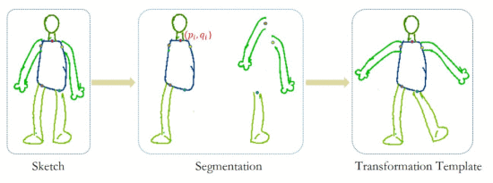
Proposed Method – Architecture
The proposed pipeline is mainly composed of three components:
Sketch component segmentation based on multi-modal DNN fusion
Multifarious sketch generation based on non-linear transformation network
Deep 3d shape reconstruction using multifarious sketches.
The first component is a 2D point cloud-based sketch segmentation model, which is used to segment a given sketch into a series of basic units and build a transformation template by the knots between them.
The advantage of this component is that it only relies on a small amount of sample data to achieve the learning task of the transformation network.
The second component is developed for generating multifarious sketches with the aforementioned transformation template.
It creates the transformation representation of a sketch by extracting the shape features of an input sketch and transformation template samples, which can avoid the problems existing in conventional models such as unitary transformation structure, distortion, etc.
The third component takes the obtained sketches as input to reconstruct 3D shapes with a generative model.
It fuses and optimizes features of multiple views and thus is more likely to generate high-quality 3D shapes. Details of each component will be introduced in the following three subsections.

Slide 8
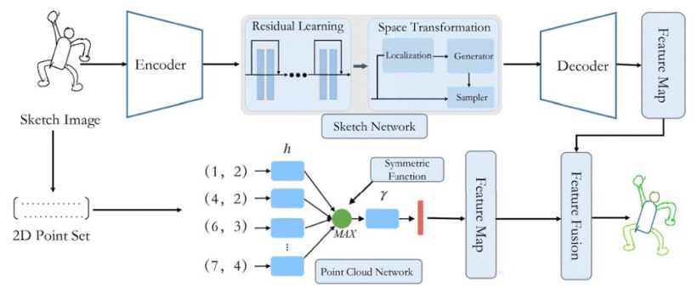
Proposed Method - Phases
Sketch Component Segmentation Based on Multi-modal DNN Fusion
The sketch network mainly consists of two parts: encoder and decoder.
On the one hand, the network obtains the global feature of a sketch through the encoder.
As shown in the below fig, feature representation is learned and extracted using spatial invariance enhanced residual (SIER), which is composed of two modules: residual learning module and spatial transformation module.
These features will be combined together in the decoding phrase to generate a pixel-level feature segmentation image.
On the other hand, the coordinate information of sketch contour is an important geometry structure. Therefore, 2D point cloud network can obtain the feature of the sketch by representing each point with 2D coordinates ( x, y ).

Slide 9
Proposed Method - Phases
Multifarious Sketch Generation Based on Non-linear Transformation Network
After performing sketch segmentation, we use the transformation templates of the original sketch to train the network.
The knot between units is represented with {( p _{i} , q _{i} )}.
Then transformation feature extraction and representation are carried out.
Transformation matrix can be decomposed into rotation part and scaling part.
The Sketch-VAE network aims to find an encoder and a decoder, where the goal of the encoder is to map the posterior distribution of x to hidden vector z, while that of the decoder is to generate a credible x.
To avoid incorrect output caused by the separation between sketch components, we add a constrain condition and define the loss function of knots for a regularization constrain to the network optimization network to avoid distortion.

Slide 10
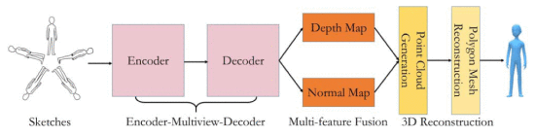
Proposed Method - Phases
Deep 3D Shape Reconstruction Using Multifarious Sketches
The proposed deep 3D shape reconstruction framework is illustrated in the below figure.
For the sketches obtained in the last step, the encoder first extracts the feature of each sketch.
It consists of a series of convolutions and all layers use ReLU as an active function.
Then the decoder transforms these features into depth and normal images, which will be fused into a 3D point cloud subsequently. The first step of fusion is to map all foreground pixels to 3D points. If the prediction probability of a pixel is larger than 50%, we consider it as a foreground pixel.
Finally, 3D model can be obtained by transforming it into polygon mesh with a Poisson surface reconstruction algorithm

Slide 11
Experiments & Results
To evaluate the effectiveness of the proposed method for 3D shape reconstruction, this paper conducted a comparative experiment on a public dataset.
To train the neural network using the ShapeNet dataset, which mainly consists of three different types of 3D models, i.e., human/humanoid, airplanes and chairs.
There are 120 sketch images in total in the test dataset.
Among them, 90 are synthetic sketches, which are generated from test images with line painting techniques; while the rest 30 sketch images are drawn by two professional artists. They were asked to draw 10 sketch images for each category.
Experiments conducted on the reconstructions produced by this method (called ShapeMVD) versus the following methods:
A network based on the same encoder as ours but using a volumetric decoder baseline instead of our Multiview decoder,
A network based on the same encoder as ours but with the Tatarchenko et al.s view-based decoder instead of our multi-view decoder.
Convolutional

Slide 12
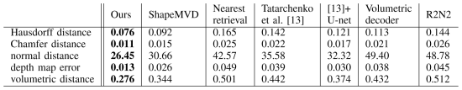
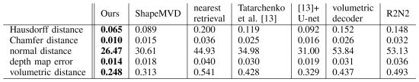
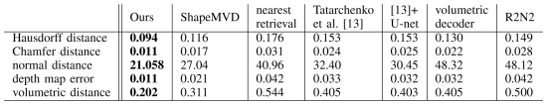
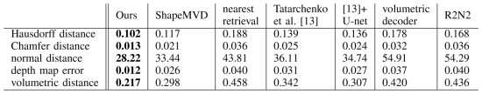
Peer sketch-based 3D shape reconstruction methods selected for comparison include ShapeMVD, Nearest retrieval, Tatarchenko et al., U-net, volumetric decoder, and R2N2, which are state-of-the-art models and widely used by existing studies for performance evaluation.
For the nearest-neighbor baseline, we extract the representation of the input test sketches based on our encoder.
This is used as a query representation to retrieve the training shape whose sketches have the nearest encoder representation based on Euclidean distance.
We additionally implemented a variant of Tatarchenko et al.’ s decoder by adding U-net connections between the encoder and their decoder.
The volumetric decoder consisted of five transpose 3D convolutions of stride 2 and kernel size 4 × 4 × 4.
The number of filters starts with 512 and is divided by 2 at each layer.
Leaky ReLU functions and batch normalization were used after each layer.
Table I Man-made objects (synthetic)
Table II Character models (synthetic)
Table III Man-made objects (human drawing)
Table IV Character models (human drawing)

Slide 13
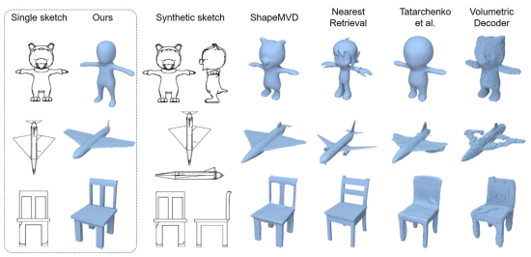
Comparison of 3D models reconstructed with different methods:

Slide 14
Conclusion
This paper is general and can be easily extended to other applications, such as biomedical, intelligent computing.
The proposed method first generates a series of sketch images from different view viewpoints by analyzing the semantic information of the input sketch image.
Then, the obtained sketch images are fed into a deep neural network to reconstruct the 3D shapes.
Compared with multi-view-based approaches, the proposed method only takes a single sketch image as input, which can significantly reduce the time used for drawing sketches and remarkably improve the reconstruction efficiency.
Besides, using the input sketch image as visual clues to generate multi-view sketch images is helpful to reconstruct 3D shapes more accurately, which is superior to conventional single sketch image-based 3D shape reconstruction methods.
Extensive experiments on a public 3D shape reconstruction dataset have demonstrated the efficacy of the proposed model.
Future Scope:
Aim to integrate other forms of input data, such as images from different datasets like ImageNet, etc., to generate more valuable and relevant 3-D information about sketch images.

Slide 15
References
F. Wang et al., "Deep 3D Shape Reconstruction from Single-View Sketch Image," 2020 8th International Conference on Digital Home (ICDH), 2020, pp. 184-189, doi: 10.1109/ICDH51081.2020.00039.

Slide 16

Questions

Slide 17
Thank you !!

